Slide 1
Sistem Operasi - Cara Merakit PC
M Alam Wahyudi - 17111050
M. Irfan Syarifuddin - 171111051
Feriansyah Priyatama - 171111090

Slide 2
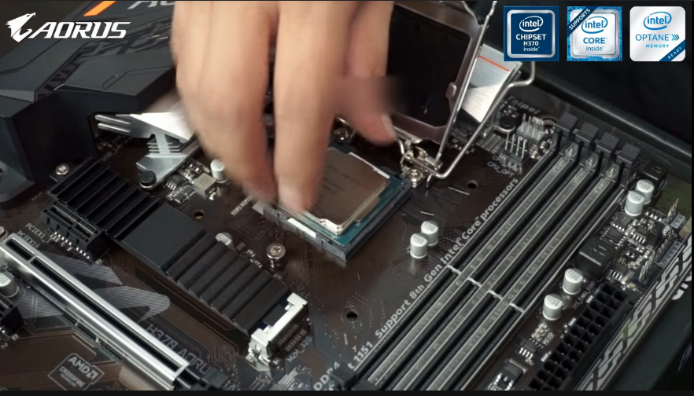
1. Pasang Processor

Slide 3
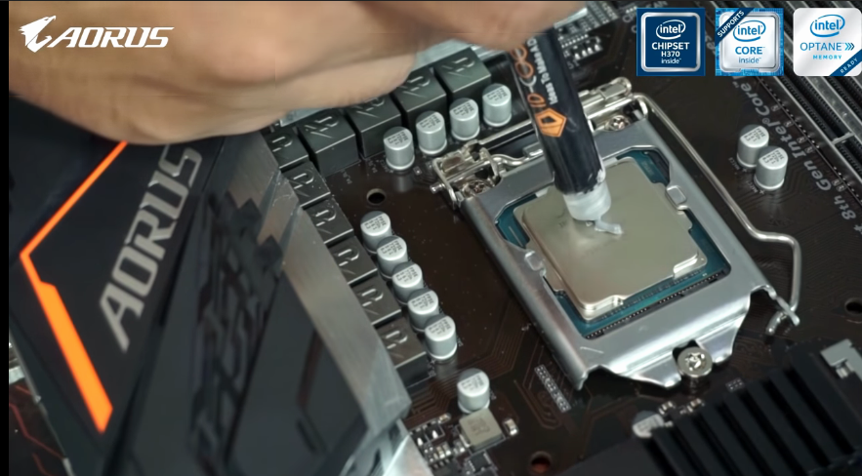
2. Beri Thermal Paste

Slide 4
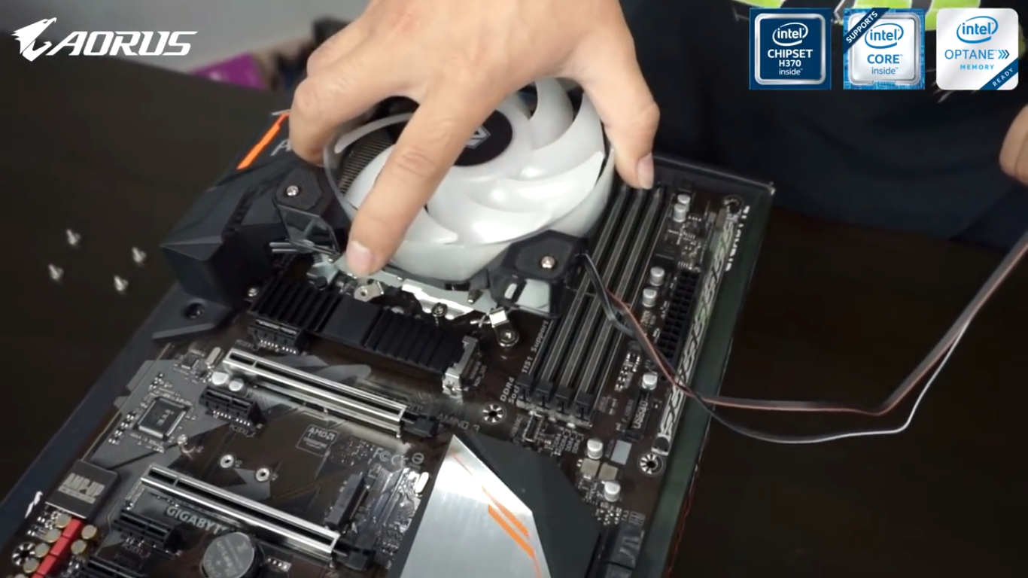
3. Pasang Heatsink

Slide 5
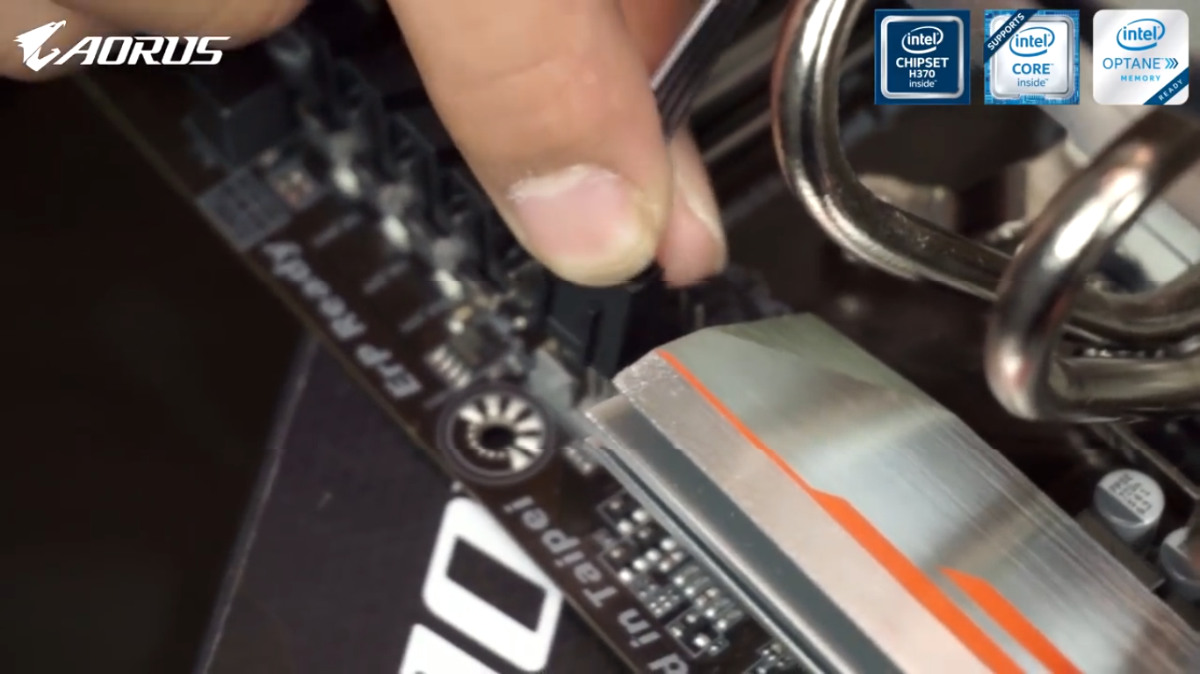
4. Pasang Kabel CPU Fan

Slide 6
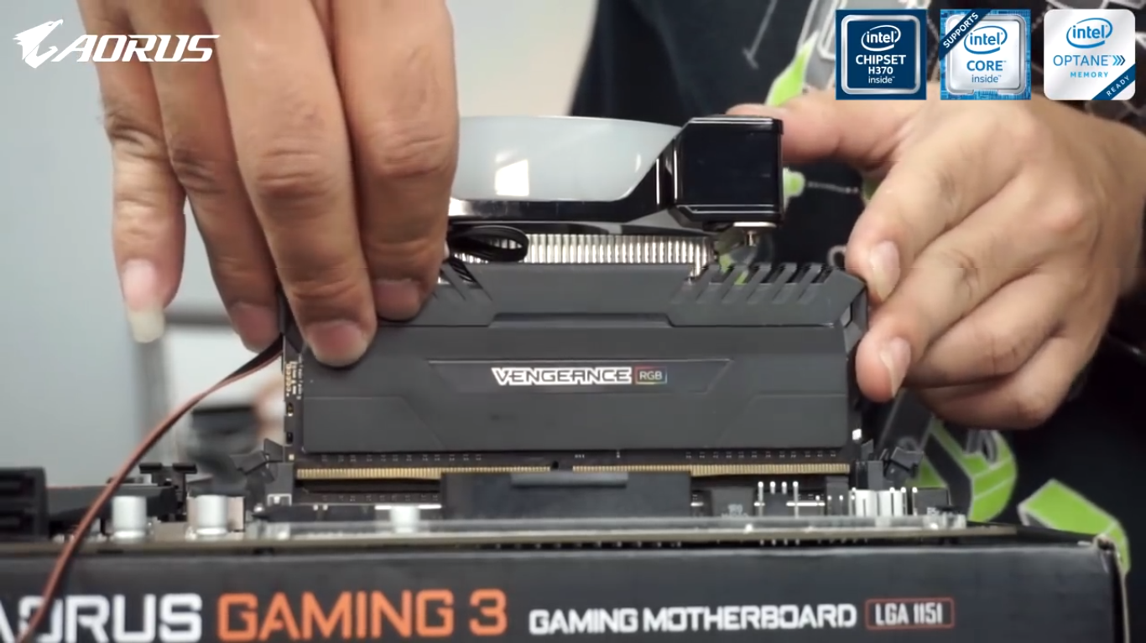
5. Pasang RAM

Slide 7
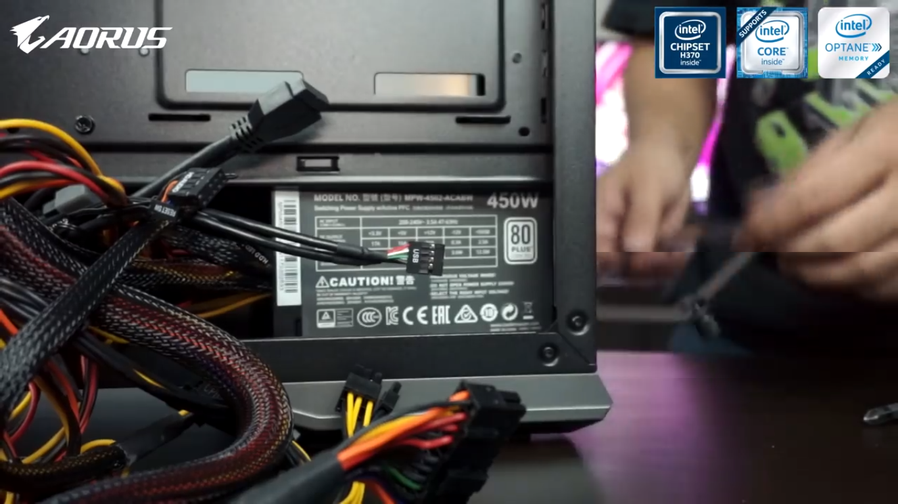
6. Pasang Power Supply

Slide 8
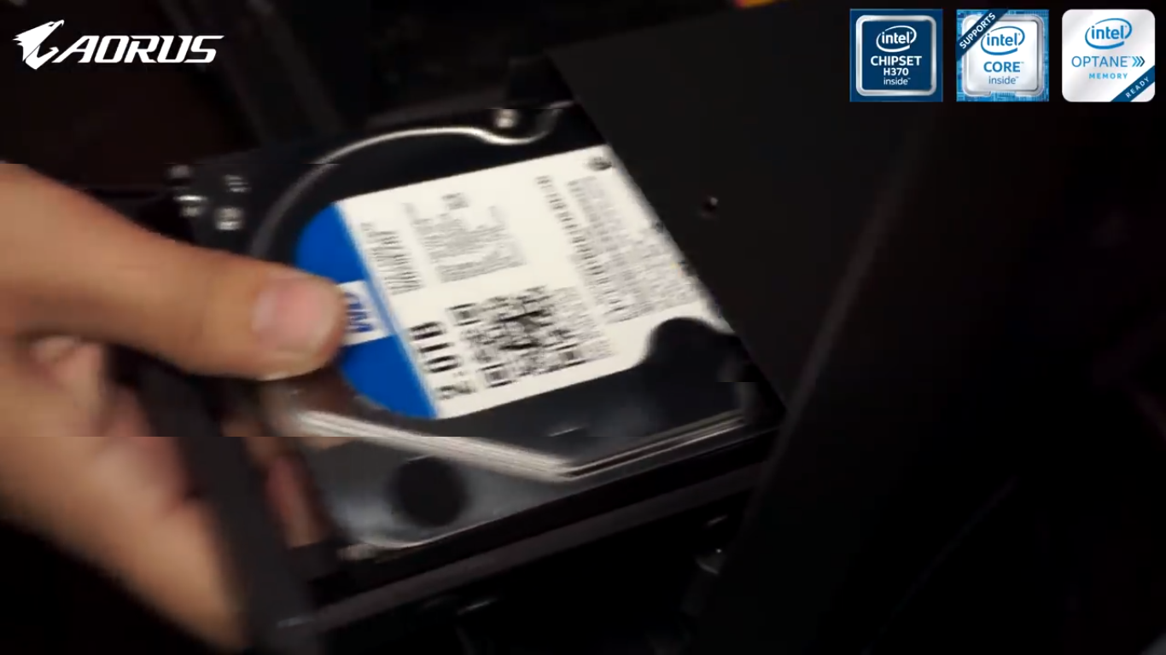
7. Pasang Harddisk

Slide 9
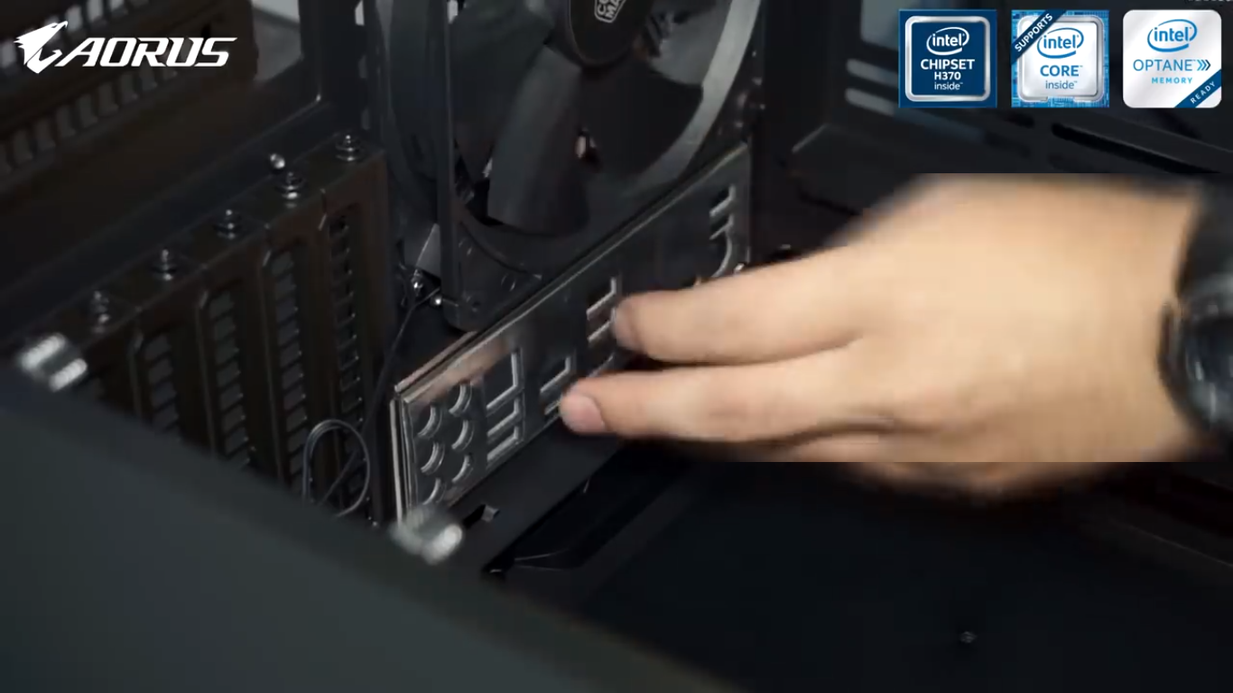
8. Pasang IO Shield/ Back Panel

Slide 10
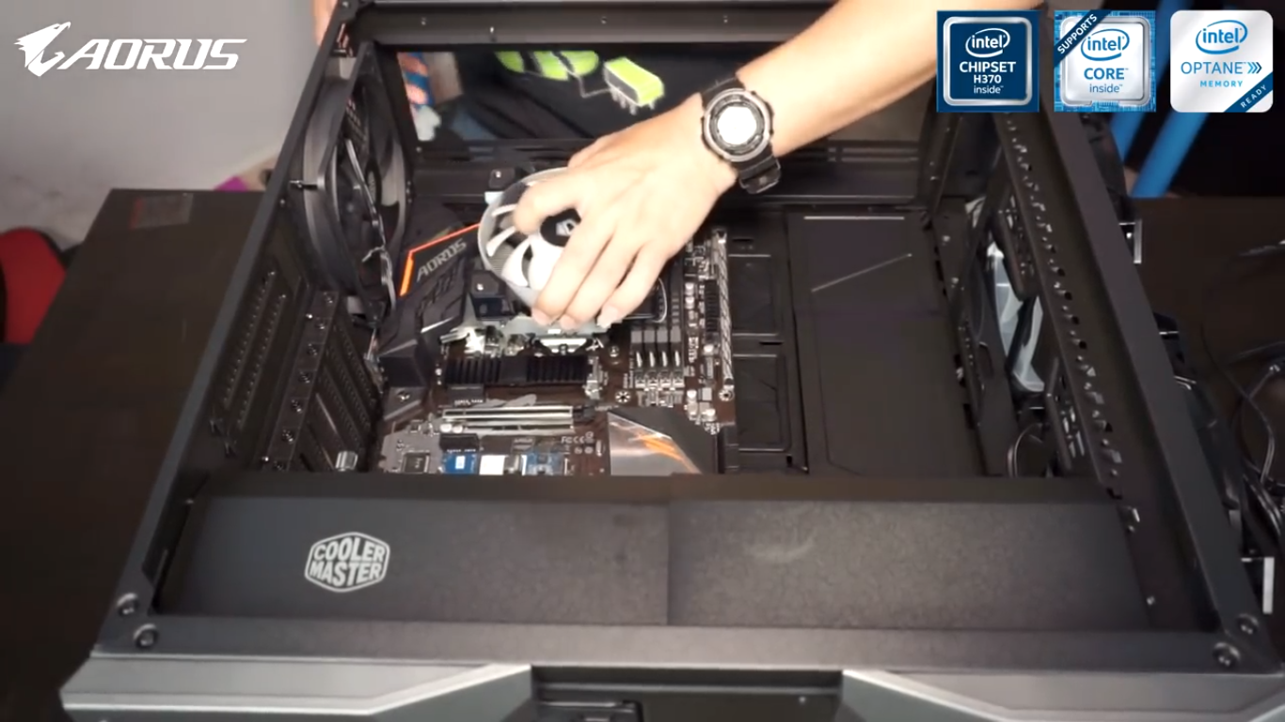
9. Pasang Motherboard

Slide 11
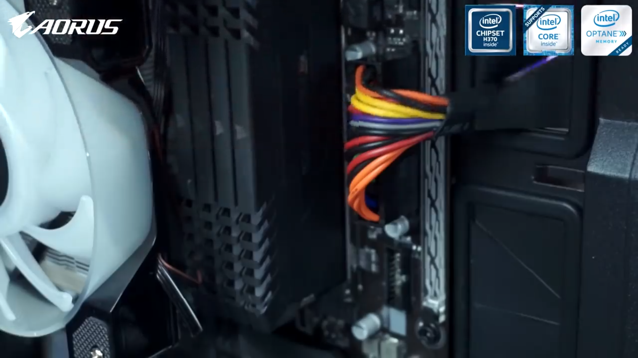
10. Pasang Kabel 24-pin

Slide 12
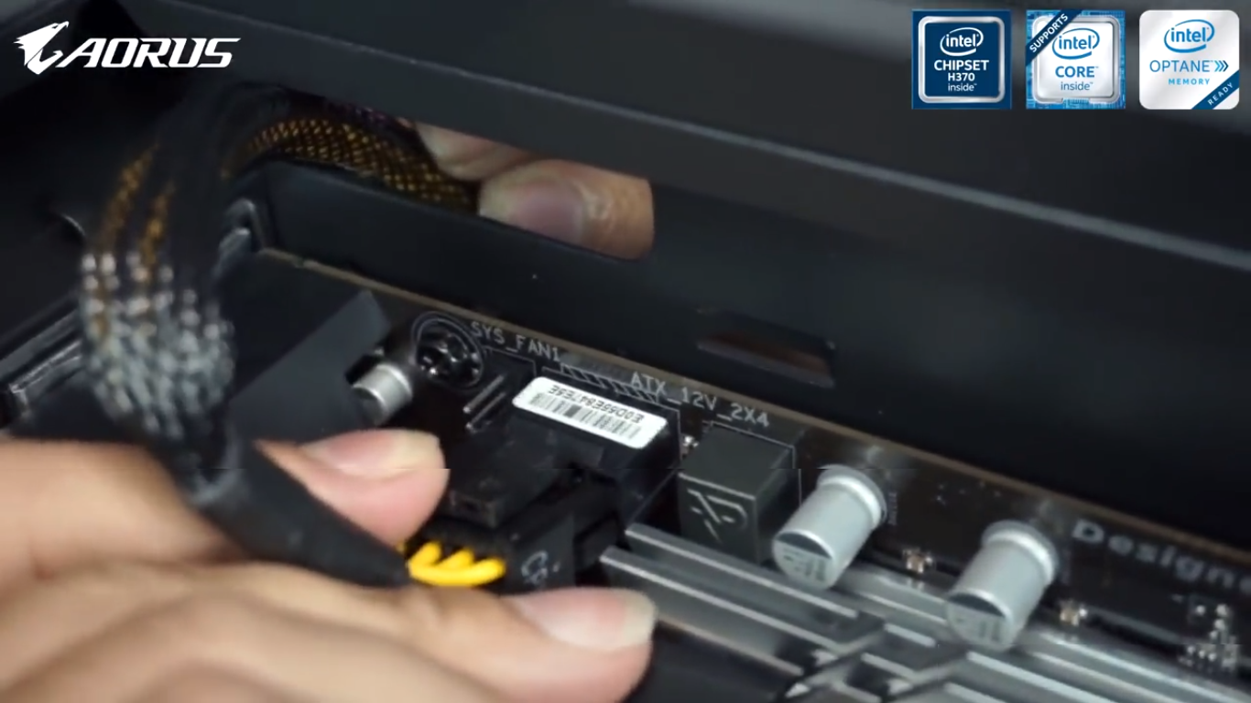
11. Pasang Kabel Power CPU

Slide 13
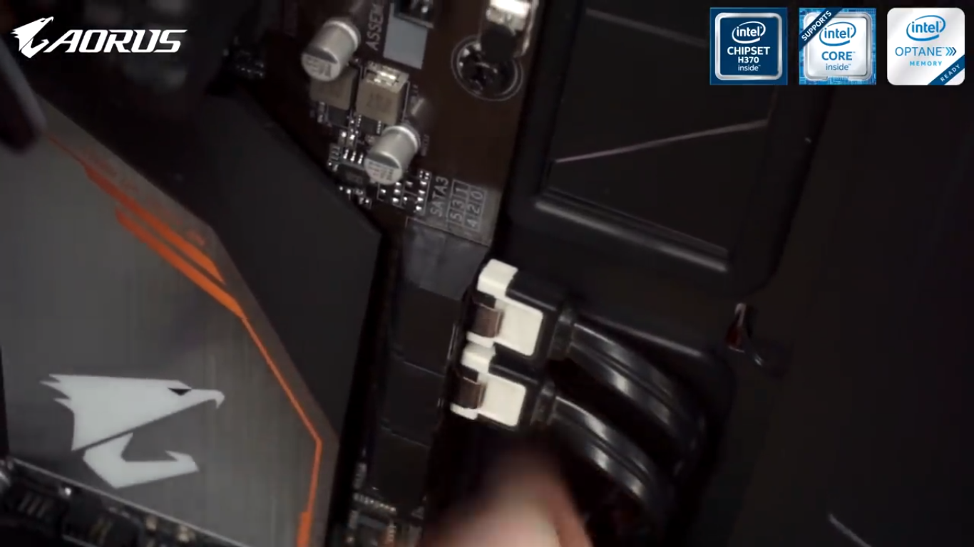
12. Pasang Kabel SATA

Slide 14
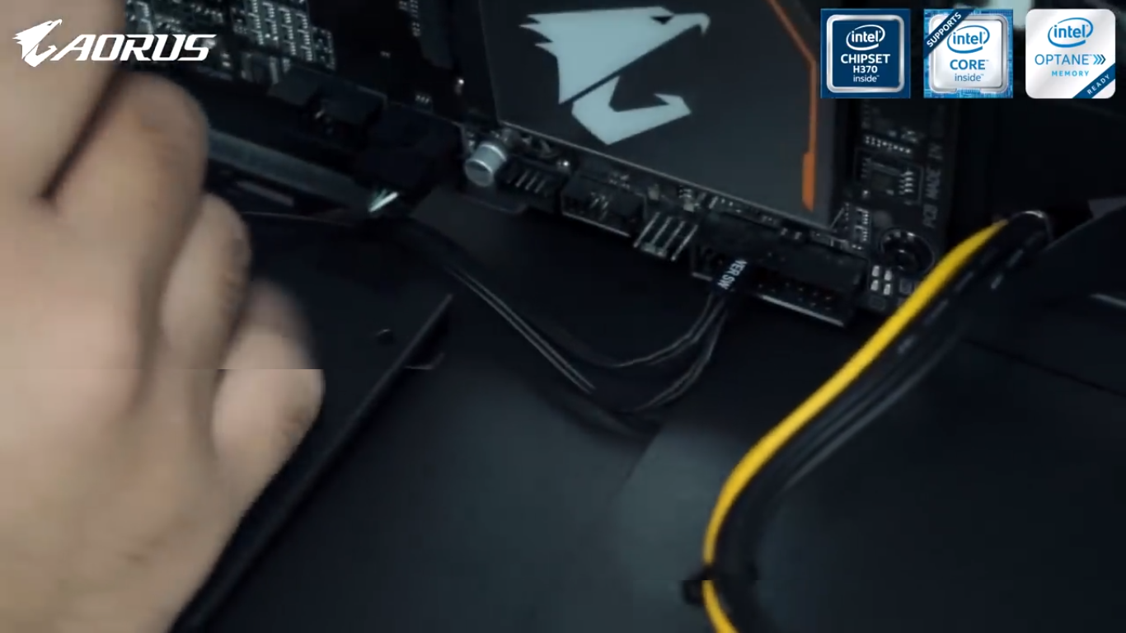
13. Pasang Kabel Front Panel

Slide 15
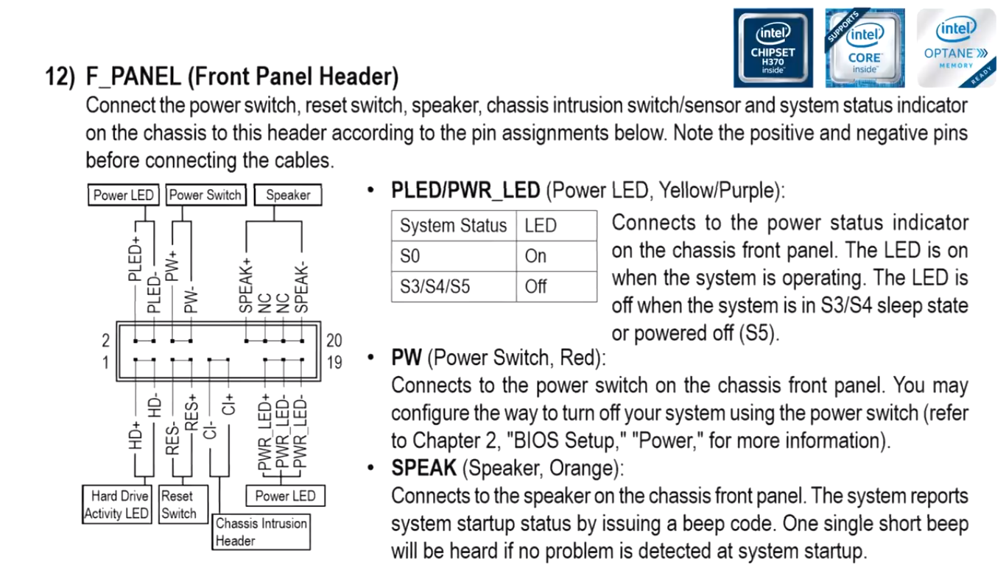
14. Layout Front Panel

Slide 16
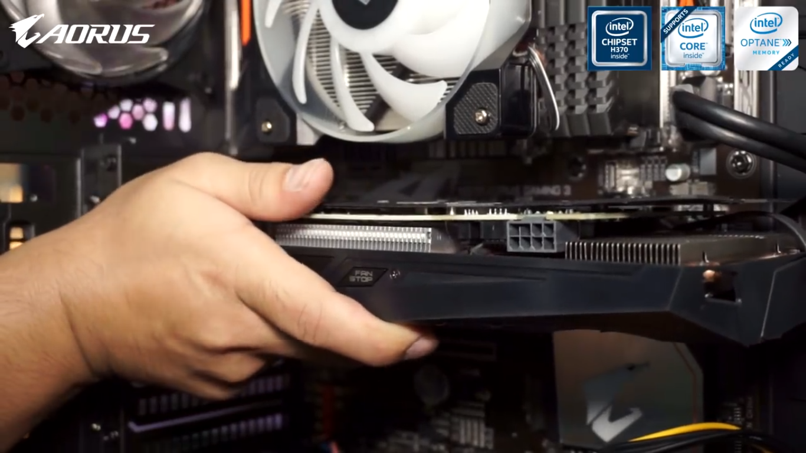
15. Pasang VGA Card

Slide 17
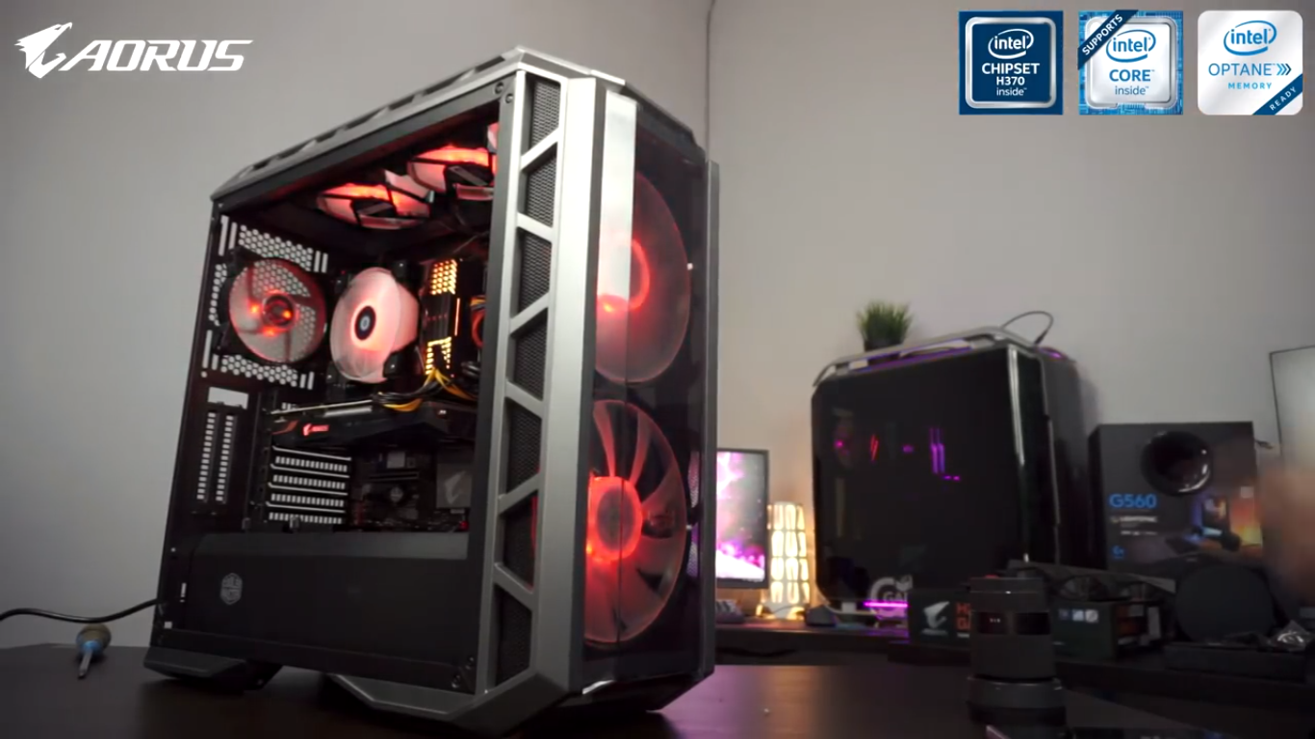
16. Nyalakan PC

Slide 18
Sumber : https://www.youtube.com/watch?v=1y4nTCjSQwg&t=177s

Slide 19
Terimakasih

